Slide 1

INTRODUCTION TO NON MONOTONIC REASONING LECTURE 4: APPLICATIONS
Computer Science Department
University of Verona - Italy

Slide 2
COURSE STRUCTURE (4)
UNIT 4: APPLICATIONS
The legal reasoning framework
Argumentation
Reasoning with the law
Defeasible deontic logic
Scientific argumentation
Sustainable arguments
Scientific ground and argumentation

Slide 3
DEONTIC DEFEASIBILITY
The actual nature of argumentation
Structure of obligations/prohibition with non monotonic form
Explicit and implicit permissions
Pledge, contrary-to-duty obligations and other fantastic animals (and where to find them)

Slide 4
STRUCTURE OF OBLIGATIONS
The most basic inherent labelling of obligations that takes into consideration defeasibility is the expression of obligation under generality of conditions

Slide 5
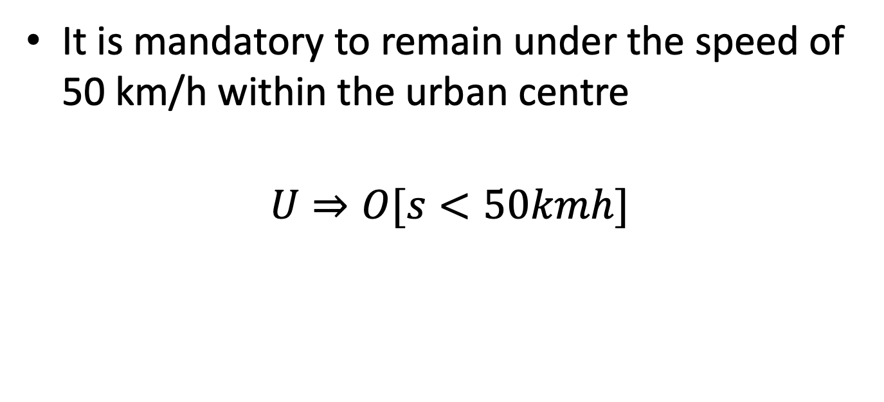
EXAMPLES
It is mandatory to remain under the speed of 50 km/h within the urban centre
$$U⇒O[s<50kmh]$$

Slide 6
FACTS AND RULE CHANGE
Facts change
General rules are written to work out different sets of facts and generate different consequences
New rules are introduced that work because of the defeasibility

Slide 7
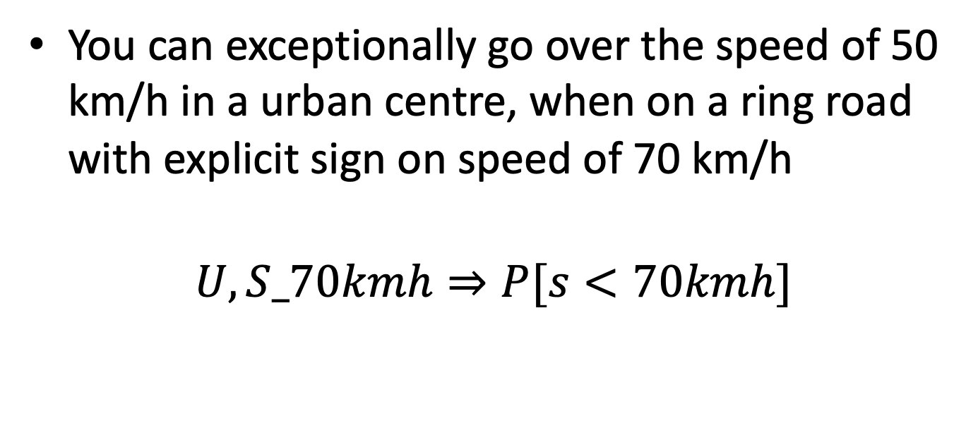
EXAMPLE
You can exceptionally go over the speed of 50 km/h in a urban centre, when on a ring road with explicit sign on speed of 70 km/h
$$U,S_70kmh⇒P[s<70kmh]$$

Slide 8
DOES THIS WORK?
It does not work directly
If we have the above rules no obligation or explicit permission is derived
Are there general superiority rules?

Slide 9
THE JURIDICAL PRINCIPLES
In the Roman Law, many principles that govern the behaviour of individuals are derived by the so called natural right
This is formed by the principles that make ethics work based on a supposed natural moral ground

Slide 10
BROCARDOS
Such principles are expressed in brocardos (in English adage, or broach)
Some of these principles are expression of viewpoints as the model of roman law was sapiential, namely it was based upon the very notion of informed opinion of a jurist

Slide 11
Ethical theories and major ethical philosophers
The World
How to understand it
Descriptive theory
The “is”
Ethical theory
The “ought”
How to change it
Action

Slide 12
Ethical philosophers
 | Utilitarianism | Deontology | Virtue
Morality depends on… | Consequences “cost / benefit” | Conformity to moral principles | Perfecting one’s character
Key philosophers | Mill, Bentham | Kant | Aristotle
Jargon | Greatest Happiness Principle | Categorical Imperative | Telos

Slide 13
BASIC SOLUTIONS TO IMPLICIT EXCEPTIONS
LEX POSTERIOR: when the law is modified in an instant of time t, then the previously existing norm is overwhelmed
LEX SUPERIOR: when two laws conflict that come from distinct institutions, the rule coming from the higher insitution prevails
LEX SPECIALIS: when a law describes a situation that is more specific than the other considers, then the most specific law prevails

Slide 14
OTHER IMPORTANT BROACHES
LEX ANTERIOR: whitin certain viewpoints on the moral ground (conservatorism, some religious theories, the so-called originalism in constitutional right theory in the USA) certain concepts expressed in the beginning of the development of a moral ground have a metaphysical origin and cannot be changed
DURA LEX, SED LEX: the so-called rule-of-law principle. Whenever the law establishes the obligation or the prohibition of something it is morally unground to violate the law. The opposite principle, often advocated against oppresion of the State is the rule-of-justice, that establishes, essentially the natural prevalence of moral grounds against the law.

Slide 15
MISINTERPRETATIONS OF THE ABOVE
Misinterpreting lex anterior generates the so-called fundamentalism. The moral ground that I predicate is true, for it comes from God, therefore my Right is to destroy the system for guaranteeing my freedom to follow my moral ground, or the State has to negotiate with me some space within which I can express my view

Slide 16
MISINTERPRETING THE RULE-OF-JUSTICE
Essentially, the rule-of-justice, when applied on the supposed prevalence of moral ground for rebellion, allow to commit unlawful activities as means to perform revolution

Slide 17
MISINTERPRETING THE RULE-OF-LAW
Implicit permissions do not constitute a moral ground. When something is not explicitely prohibited performing it does not mean that the action is ethically consistent.

Slide 18
FUNCTIONALISM VS MORALISM
Moral ground to the law is evident
The idea that the moral ground has to be preserved anuhow is the logical base of the moralistic viewpoint on the law
Functionalism is the viewpoint that assumes the law to work as an engineering work, whose purpose is to reduce the risk related to a specific negative event

Slide 19
PUNISHMENTS
A punishement, in the moralistic view, re-establishes ideality of the world
In the functionalistic viewpoint, it mitigates the effects of the violation

Slide 20
PREVENTION AND DETERRENCE
A punihsment can have an effect of deterrence, as it makes less likely to commit a violation, for the violation is unconvenient
The law can prevent the crime, for it makes it less likely by the moral suasion effect
The law can prevent the crime by the anti-triggering action (the most scientific viewpoint on the development of the law)

Slide 21
EXPRESS CHANGE
Reforms can be made of three acts:
Introduction of a novel rule to be covering a behaviour not included in the cases so far
Abrogation of an existing rule that would be provoking a conflictual effect that is unsolved based on the above mentioned principles

Slide 22
CONFLICTS ON LEGAL PREVALENCE PRINCIPLES (1)
When a novel norm is introduced that makes a new case on a moral ground that conflicts with the previous one moralistic viewpoint can detect a double conflict (lex anterior-lex posterior)
Analogously when a special norm is introduced that does not follow a principle of prevention/deterrence/mitigation that is provided in the general provision the functionalist viewpoint may advice a conflict (lex specialis-lex superior)

Slide 23
CONFLICTS ON LEGAL PREVALENCE PRINCIPLES (2)
When a novel norm introduces an implicit reform of a provision introduced in a higher level of institutions or at a higher level of law (lex superior-lex posterior)

Slide 24
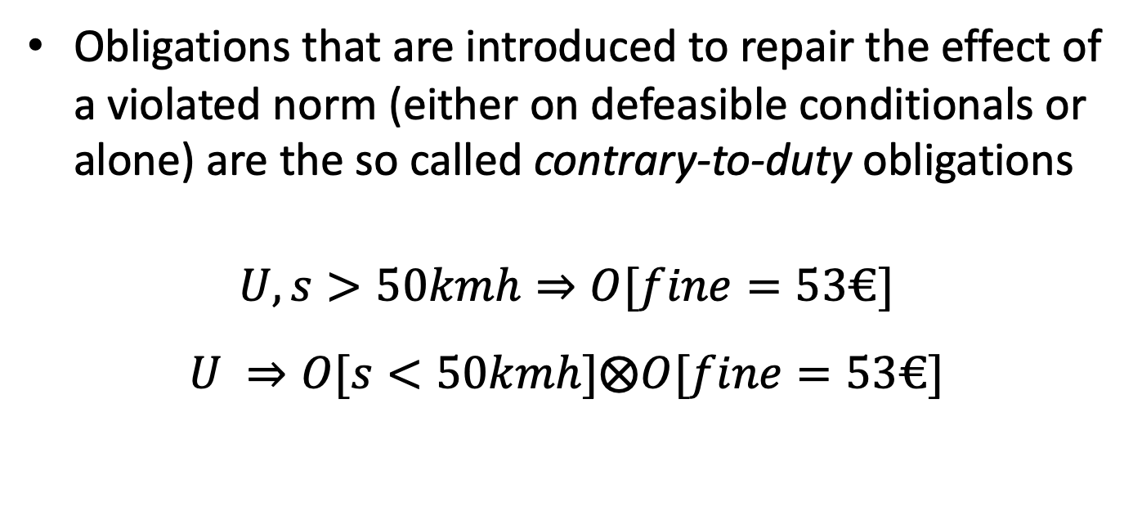
REPAIR CHAINS
Obligations that are introduced to repair the effect of a violated norm (either on defeasible conditionals or alone) are the so called contrary-to-duty obligations
$$U,s>50kmh⇒O[fine=53€]$$
$$U ⇒O[s<50kmh]⨂O[fine=53€]$$

Slide 25
DEFEASIBLE ARGUMENTS
Legal case debate is obtained by legal argumentation
Legal argumentation is based upon the usage of legal principles including informal ones and the law

Slide 26
ARGUMENTATION STRUCTURE
When a subject A proposes an argument that is grounded on facts for the case X, then a subject B can rebut or undercut the argumentation of A by a counter-argument
The struggle between arguments and counter-arguments is a litigation that is judged by a third party (the justice)

Slide 27
ARGUMENTATION EXAMPLE
Prosecution: (1) The defendant has been seen in the place where the crime was committed, and no one was there at the same time
Defence: (2) He was not there
For (1) prosecution has an evidence (e1 – a picture)
For (2) defence has an evidence (e2 – a testimony)

Slide 28
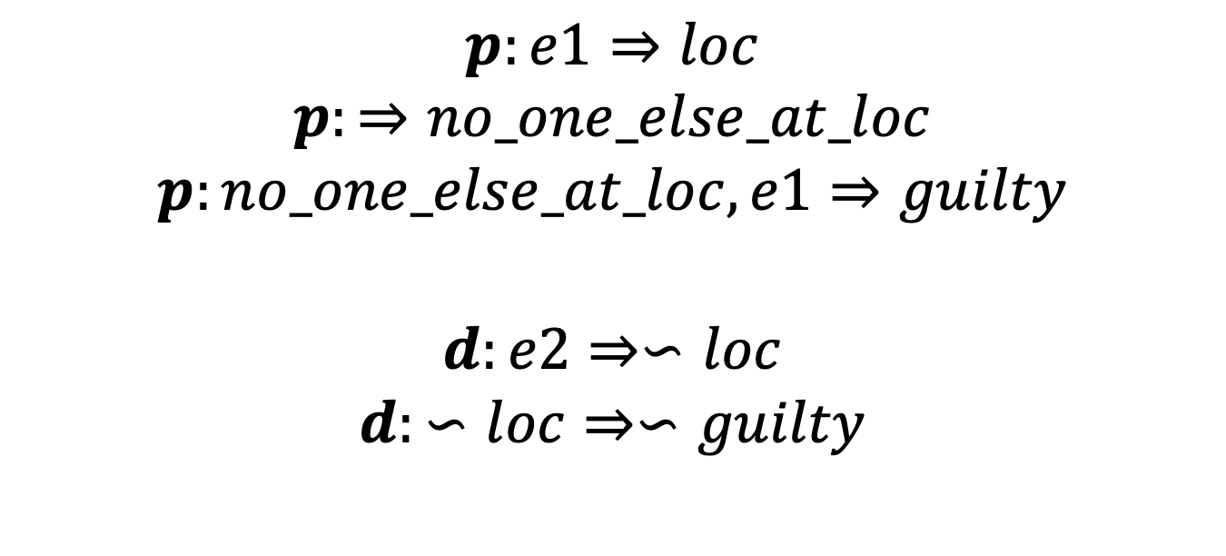
REPRESENTATION OF THE LITIGATION
$$p:e1⇒loc$$
$$p:⇒no_one_else_at_loc$$
$$p:no_one_else_at_loc,e1⇒guilty$$
$$d:e2⇒∽loc$$
$$d:∽loc⇒∽guilty$$

Slide 29
SCIENTIFIC ARGUMENTATION

Slide 30
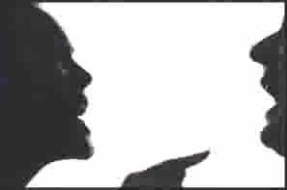
Why scientific argumentation?
Argumentation is about making claims and providing justification for those claims.

Slide 31
What scientific argumentation is NOT
a debate but what scientists do everyday!
Scientists engage in argument to
Defend claims using evidence and reasoning
Defend models using evidence
Critique the claims of other scientists and look for sufficient and appropriate evidence

Slide 32
Reasons scientists use arguments
Interpretation of data
Experimental designs
Method of data analysis
The appropriateness of a questions
“Observation and experiment are not the bedrock upon which science is built; rather they are handmaidens to the rational activity of constituting knowledge claims through argument (Newton, Driver, Osborne 2000).”

Slide 33
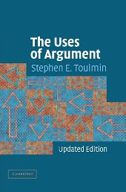
Stephen E. Toulmin
The Uses of Argument (1958, revised 2003) Cambridge University Press

Slide 34
The Toulmin Model
A tool for structuring arguments

Slide 35
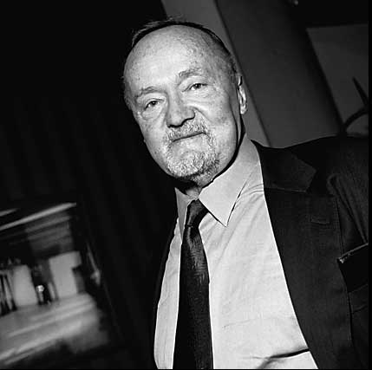
Stephen Toulmin
Stephen Toulmin (1922-2009), was a British philosopher who became frustrated with the inability of formal logic to explain everyday arguments, which prompted him to develop his own model of practical reasoning.

Slide 36
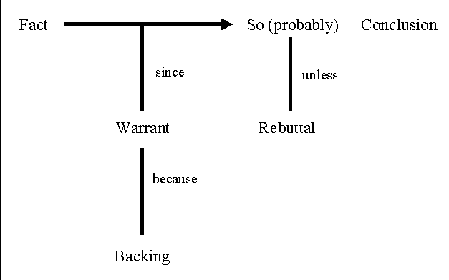
Toulmin’s Model
Claim
Fact/Grounds/Data (Evidence)
Warrant (Chain of Reason)
Backing
Rebuttal
Qualifier

Slide 37
Toulmin’s model of reasoning has some similarities to formal logic, including the syllogism.

Slide 38
The Syllogism
A syllogism is an example of formal logic
It comprises three parts:
Major premise
Minor premise
Conclusion
All men are mortal
Socrates is a Man
Therefore, Socrates is mortal

Slide 39
The Syllogism
The major premise is a generalization, a broad proposition
The minor premise is a specific application of the major premise
The conclusion follows logically from the premises.

Slide 40
The Enthymeme
An enthymeme is another ancient form of reasoning.
An enthymeme is essentially a syllogism with an unstated premise
In conversation, an enthymeme occurs as a claim with a reason attached (e.g. Let’s eat at McDonalds because their fries are good).

Slide 41
Toulmin’s model resembles the enthymeme, in that a claim is connected to a reason. The unstated premise of an enthymeme is called the warrant in the Toulmin model.

Slide 42
The three basic elements:
Claim (assertion or proposition)
Grounds (proof, data, support, evidence)
Warrant (a logical and persuasive connection between the grounds and the claim)

Slide 43
Claims
A claim is the point an arguer is trying to make. The claim is the conclusion, proposition, or assertion an arguer wants another to accept.
The claim answers the question, "So what is your point?”
example: “Rosario is an American citizen, because she was born in the United States.”
example: “Because the groundhog saw his shadow, there will be six more weeks of winter.”

Slide 44
More about claims...
There are three basic types of claims:
factual: claims which focus on empirically verifiable phenomena
Value: claims involving opinions, attitudes, and subjective evaluations of things
policy: claims advocating courses of action that should be undertaken

Slide 45
Grounds (proof or data)
Grounds refers to the proof or evidence an arguer offers.
Grounds can consist of statistics, quotations, reports, findings, physical evidence, or various forms of reasoning
example: “I’m a vegetarian. One reason is that I feel sorry for the animals. Another reason is for my own health.”
example: “I made the dinner, so you can do the dishes.

Slide 46
More about grounds...
Grounds are the support the arguer offers on behalf of his/her claim. The grounds answer questions such as:
"What is your proof?“
"How do you know?“
"Why?”
example: “It looks like rain. The barometer is falling.”
example: "The other Ritz Carlton hotels I've stayed at had great pools, so I'll bet this one has a great pool too."

Slide 47
Still more about grounds...
grounds can be based on:
evidence: facts, statistics, reports, or physical proof
source credibility: authorities, experts, celebrity endorsers, a close friend, or someone's say-so
analysis and reasoning: reasons may be offered as proof
assumptions already held by the listener

Slide 48
Clue words for identifying grounds
The grounds for an argument often follow words such as “because,” “since,” “given that…”
example: “Airports should x-ray all luggage because a bomb could be placed in checked baggage.”
example: “I expect to do well on the test, since I studied all night for it.”

Slide 49
Warrants
A warrant links the grounds to a claim, legitimizing the claim by showing the grounds to be relevant.
The warrant is a generalization that may be explicit or implicit (unspoken)
It answers the question 'Why do those grounds mean your claim is true?'

Slide 50
The warrant is an inferential leap that connects the grounds with the claim. The warrant is typically implicit (unstated) and requires the listener to recognize the connection between the claim and grounds The implicit nature of warrants means the “meaning” of an argument is as much a part of the receiver as it is a part of the message. Some arguments are “multi-warranted,” e.g., based on more than one inferential leap

Slide 51
Like the warrant in legal situations (a search warrant, for example), a sound warrant in an argument gives you authority to proceed with your case. It tells your readers what your assumptions are.

Slide 52
Assumptions
An assumption is something taken for granted, a supposition. It is often a belief or value that usually is unexamined by the person who holds it.

Slide 53
Audience
An effective arguer considers the assumptions on which her argument is based and the assumptions probably held by the audience.

Slide 54
If readers accept your warrant, you can then present specific evidence to develop your claim. If readers challenge your warrant, you must defend it by “backing” it up.

Slide 55
More about warrants...
The warrant performs a "linking" function by establishing a mental connection between the grounds and the claim
example: “Muffin is running a temperature. I’ll bet she has an infection.”
example: "That dog is probably friendly. It is a Golden Retriever.”
(warrant: sign reasoning; a fever is a reliable sign of an infection)
(warrant: generalization; most or all Golden Retrievers are friendly)

Slide 56
Still more about warrants...
warrants can be based on:
ethos: source credibility, authority
logos: reason-giving, induction, deduction
pathos: emotional or motivational appeals
value premises: values shared by, or presumed to be shared by, the receiver(s)
note: These categories aren't mutually exclusive; there is considerable overlap among the three.

Slide 57
The Toulmin model of reasoning is more flexible than formal logic and therefore works better in real-life situations. Qualification helps achieve this flexibility.

Slide 58
qualifiers (words and phrases that place limits on claims) play an essential role in arguments.

Slide 59
A qualifier limits a claim Some qualifiers: usually, sometimes, in most cases, often, few, many, it is possible, perhaps, rarely, in some cases.

Slide 60
The qualifier indicates the strength of the leap from the grounds to the claim and may limit how universally the claim applies.

Slide 61
Toulmin logic, in fact, encourages you to limit your responsibilities in an argument through the effective use of qualifiers. You save time if you qualify a claim early in the writing process.

Slide 62
Here’s an unqualified claim: People who don’t go to college earn less than those who do.

Slide 63
And a qualified version: In most cases, people who don’t go to college earn less than those who do.

Slide 64
Your SAT scores are in the 98th percentile, so you will get into a top-notch college if you want to. (an unqualified claim)

Slide 65
Your SAT scores are in the 98th percentile, so you probably will get into a top-notch college if you want to. (qualified claim)

Slide 66
Another part of the Toulmin model is the reservation, which states cases in which the claim does not apply.

Slide 67
Reservations
Often reservations are preceded by words like “unless” or “except.”

Slide 68
Rebuttal
When making an argument, you must take into consideration other conflicting viewpoints and deal with them fairly. You need to answer questions and objections raised in the minds of the audience.

Slide 69
If you fail to do so, your own argument will be weakened and subject to attack and counter-argument

Slide 70
The rebuttal is the where the author addresses the audience's opposing viewpoints or possible objections in order to strengthen his/her argument.

Slide 71
Sometimes rebuttal will be directed to opposing claims; other times rebuttal will be directed at alternative interpretations of evidence or new evidence.

Slide 72
The rebuttal can also be a place where the author concedes any weaknesses in his/her own argument or strengths in opposing arguments, but then carefully qualifies the effect these weakness have on the general strength of his/her original argument.

Slide 73
In the Toulmin model, one moves from grounds to claim, based on evidence, interpreted by warrant, and making allowances for reservations.

Slide 74
Example: “Needle exchange programs should be abolished [claim] because they only cause more people to use drugs.” [reason]

Slide 75
The unstated warrant is: “when you make risky behavior safer you encourage more people to engage in it.”

